Slide 1
If you haven’t done it yet, please download anaconda

Slide 2
Today’s exercises, answers, and this presentation are in:
https://github.com/JoanaBSilvestre/CodeClub
Download the zip file pressing on the download button

Slide 3
Programming as a concept
Giving instructions to a really really dumb entity

Slide 4


- Beat two whole eggs
Human
Computer

Slide 5
Giving VERY precise instructions and assuming the computer knows nothing

Slide 6
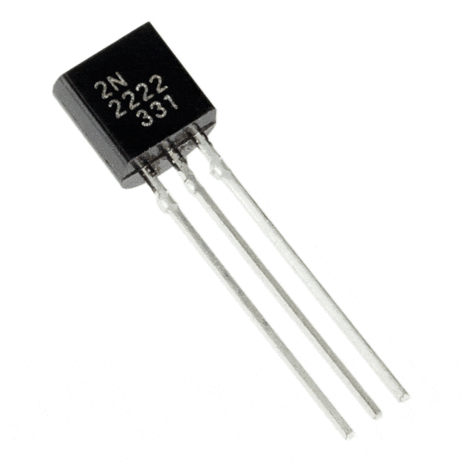
How does the computer do what you want?
Transistor
1
0
This is… binary!

Slide 7

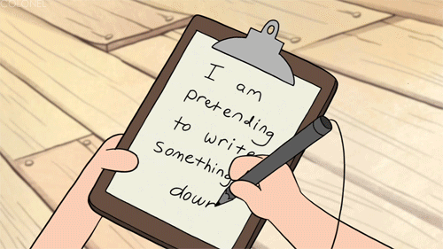
We don’t need to know binary to program
Languages can be
Low level
High level
Closer to the computer
Closer to the humans

Slide 8
There are many computer languages out there
Why choose Python?
The syntax is easy
You can already learn R by consulting the old code club
I like it

Slide 9
Before Python… let’s take a look at your terminal…
Windows: search for cmd, and open command prompt
Mac: go launchpad > other> terminal

Slide 10
Here, things become slightly different..
Mac vs PC
https://ss64.com/bash/
https://ss64.com/nt/

Slide 11


Let’s play with some commands
cal cat cd
clear cp
date ls mkdir
mv pwd rm
CD CLS COPY
DATE DEL DIR
ERASE MD
MOVE NOW
flags: -h -l -a -t -f
?

Slide 12
File structure and how to access them
HOME
aka ~
Documents
Desktop
Downloads
CodeClub
Going up one level: ../
~/Documents/CodeClub

Slide 13
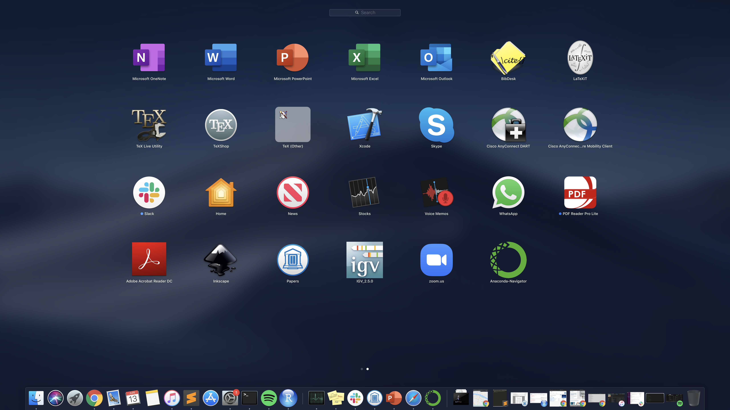
Finally, let’s move to python!
Go to the folder where you have saved week0.ipynb
Use the command line you just learned!
When you get there, type:
jupyter notebook week0_exercise.ipynb
If you want to be faster, type tab after “w”
Easy alternative:

Slide 14
Questions?

